Slide 1
Final Project
Earning Prediction After 10 Years of Graduation

Slide 2
Team members
Parisa Hemmati
Caijuan Luo(Kate)

Slide 3
Project background
Which school alumni have higher earning after 10 years?

Slide 4
Project Goal
Our goal is to build a model that would accurately predict the earnings of a college's graduates after ten years based on the specific features of the college like average cost of attendance, acceptance rate, average test scores, tuition fee etc.
Because of the high tuition fees of schools and high value of student debts, earnings after graduation are a major factor to choose schools and programs and play an important role in ability of the students to repay loans. This model will help students to compare different earnings of colleges alumni and make more informed decisions.

Slide 5
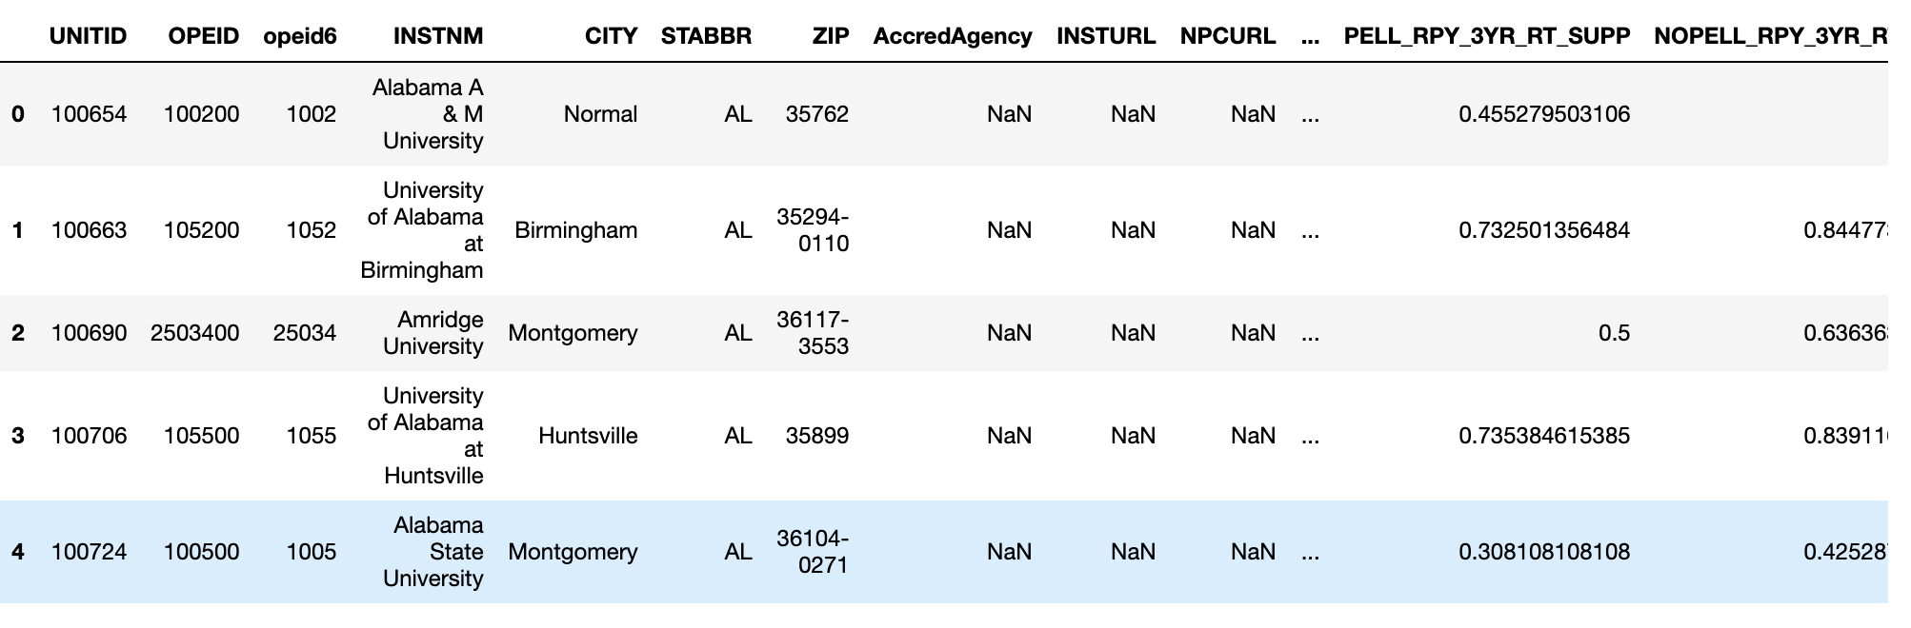

Project Data
Data: College Scorecard dataset
Size: 17 CSV files with all the years data (from 1996 - 2013), each file contains about 7000 rows and more than 1700 columns

Slide 6
Data Structure
Data mainly falls into below categories
Root:
Refer to the most basic information in the dataset, like ID, OPE ID for institutions, longitude and latitude
School:
Refer to the most basic information of school like school name, institution id, school degrees_awarded.highest, ownership
Student:
Refer to the demographic data, test scores, family income data like demographics.race_ethnicity, family_income.overall
Academic:
Data about the percentages of students in each major, like Percentage of degrees awarded in Engineering.
Admissions:
Refer to the test score and admission rate like Average SAT equivalent score of students admitted, Midpoint of the ACT writing score

Slide 7
Data Structure
Data mainly falls into below categories
Aid:
Refer to the financial aid information and debt, like Percentage of undergraduates who receive a Pell Grant, the median debt for students who have completed
Cost:
Refer to the cost of entering school, like Average cost of attendance (program-year institutions),Tuition and fees for program-year institutions
Earning:
Refer to the demographic data, test scores, family income data like demographics.race_ethnicity, family_income.overall
Repayment:
Data about debt repayment values, like Two-year cohort default rate, Three-year cohort default rate
Completions:
Refer to the test score and admission rate like Completion rate for first-time, full-time students at four-year institutions

Slide 8
Data pattern
The student loan rate increase yearly
Students graduated from some colleges have more incomes compare with others, so they can pay the loans early
Median earnings of students 10 years after entry, average cost of attendance, median debt for students who have completed, etc are some other important features.

Slide 9

Feature selection
1700+ columns , How to choose?

Slide 10
Feature selection
2 Approaches:
1- Select related features manually
2- Use feature selection algorithms

Slide 11
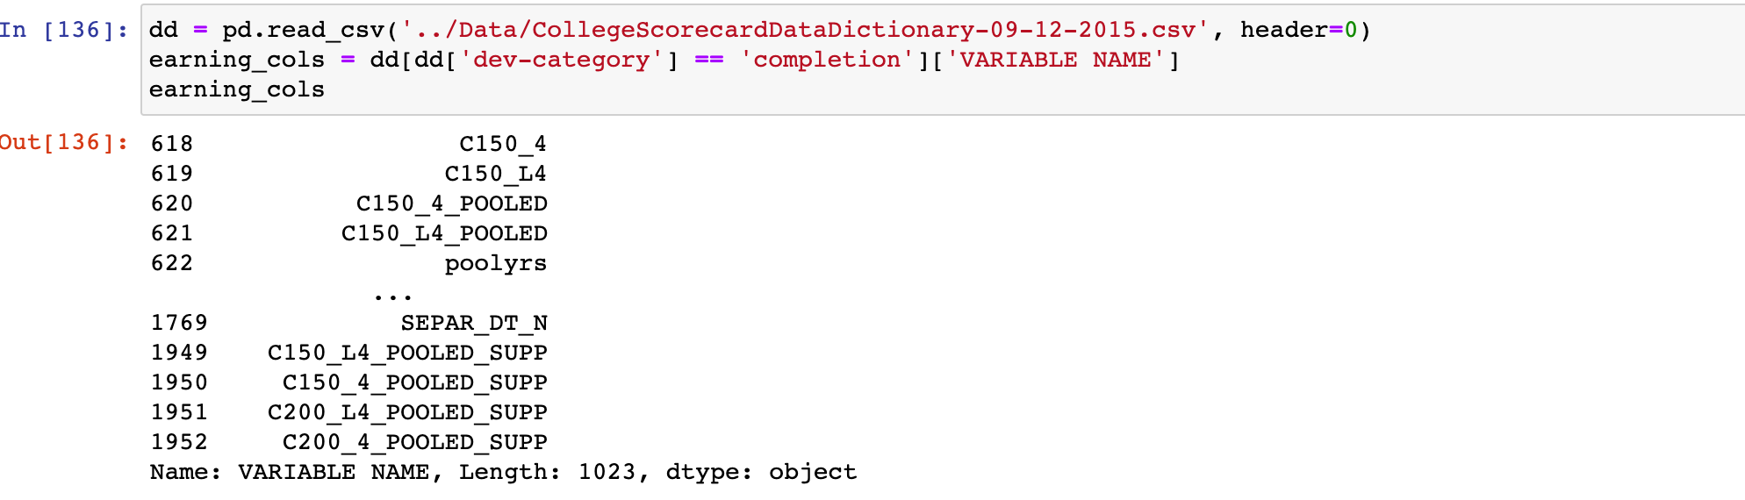
Approach 1
Why we will have this silly method? To select the features manually?
Reason 1: we have so many columns and the columns name is not easily to understand, like what is the C150_4 , what ’s the COMP_ORIG_YR2_RT

Slide 12
Approach 1
Why we will have this silly method? To select the features manually?
Reason 1: we have so many columns and the columns name is not easily to understand, like what is the C150_4 , what ’s the COMP_ORIG_YR2_RT

Slide 13
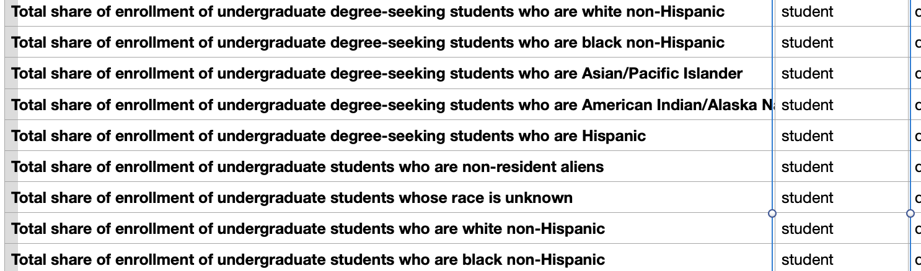
Approach 1
Why we will have this silly method? To select the features manually?
Reason 2: we observe that some columns may not contribute to the prediction of our target or the columns are almost filled with NaN value . We will use correlation metric to filter this data.

Slide 14
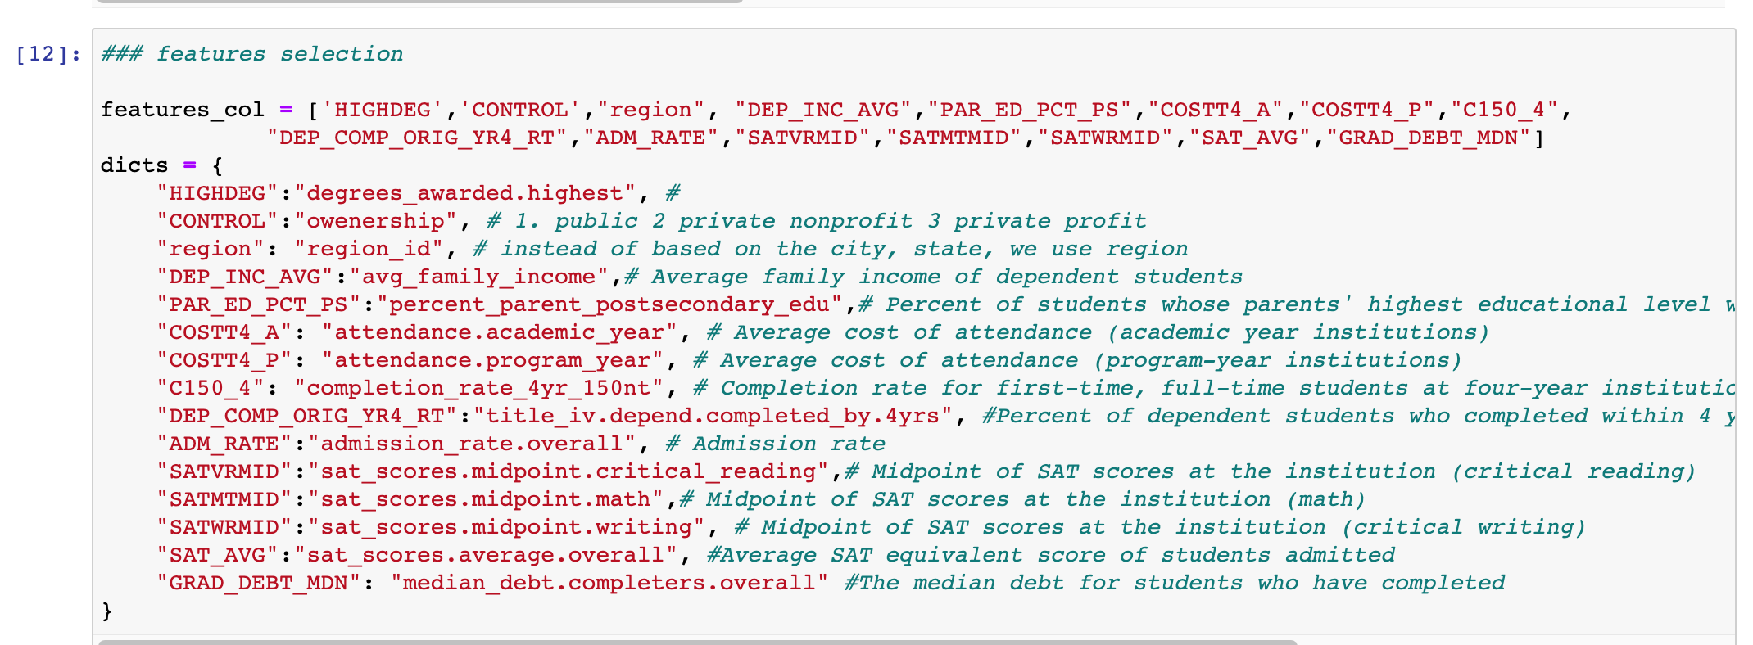
Approach 1

Slide 15
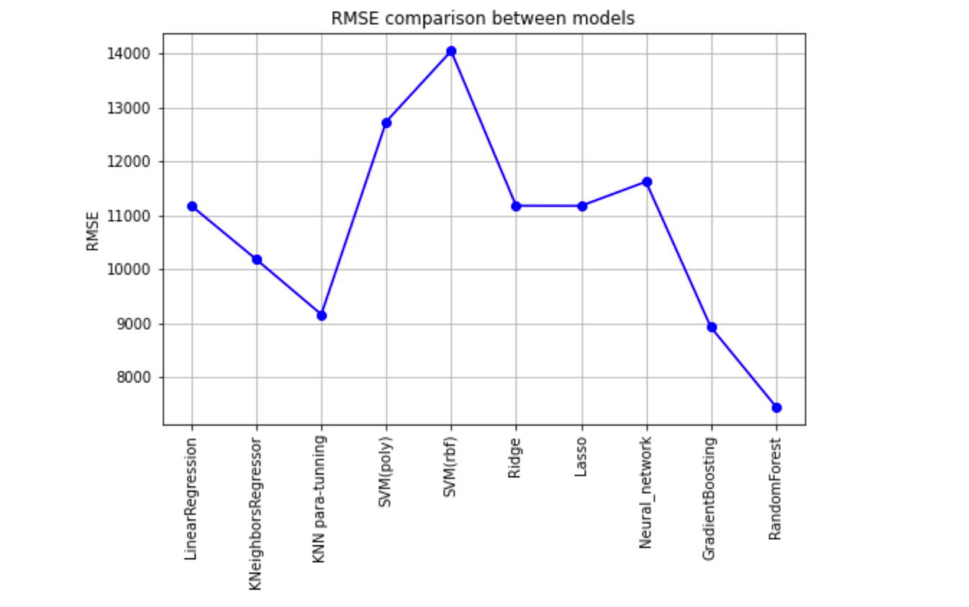
Model Trying(Approach 1)
Linear regression which is our base model
KNN
KNN para-tunning
SVM (Poly)
SVM (rbf)
Ridge
Lasso
Neural_network
GradientBoosting
RandomForest

Slide 16
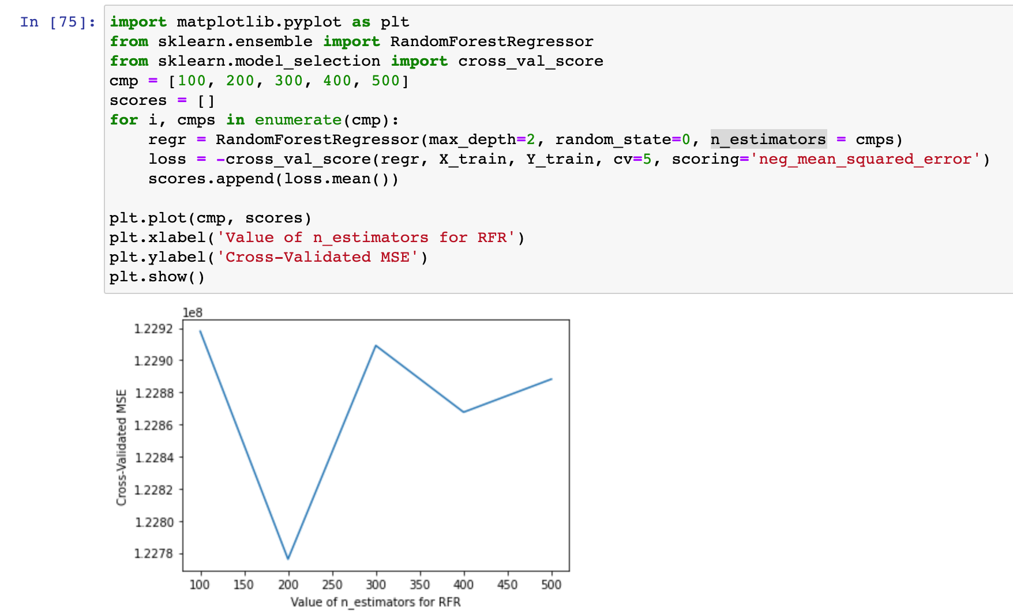
Parameter Tuning(Approach 1)
Try to improve the performance of Random Forest mode buy the performance is still quite low .
RMSE : 7415.816902246269

Slide 17
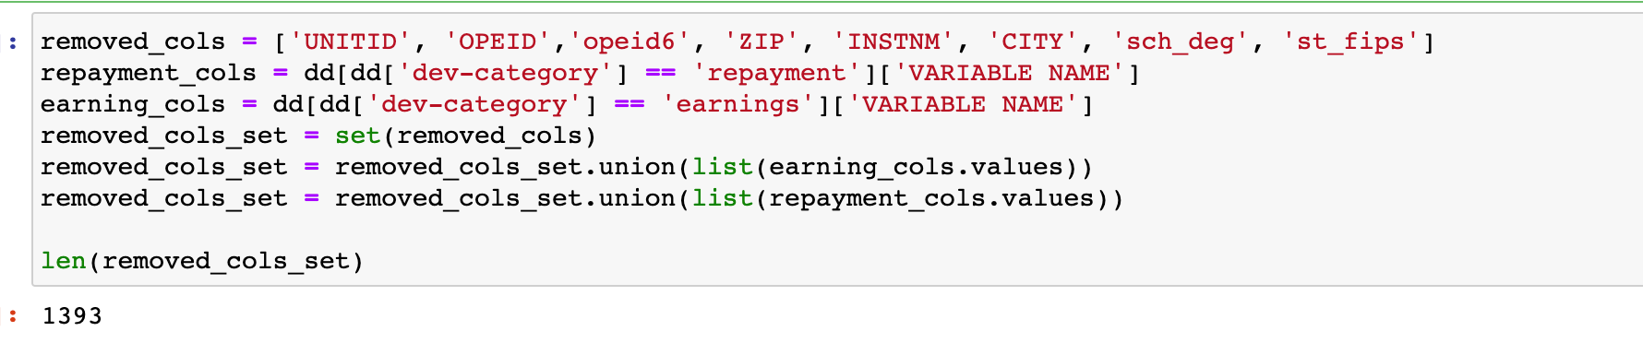
Approach 2
Step 1:
We first eliminated all features that had nonnumerical/categorical values
Step 2:
We removed all features related to earnings, and repayment. Since we are predicting earnings, we need to remove any other metric in these categories that is highly correlated with predict target
Step 3:
We removed all columns with privacy suppressed values
Code:

Slide 18

Now we just have 408 columns! Hummm, just… ?
Approach 2

Slide 19
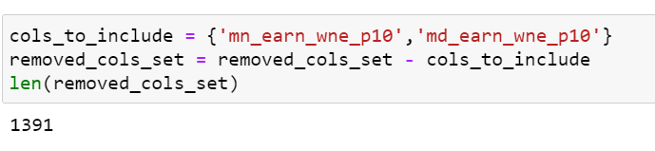
DATA clearing
Added median and mean earning after 10 years columns to the dataset
Handling NaN data
Transform columns type from object to Integer or float

Slide 20
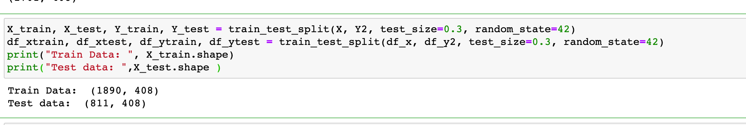
Datadat Spliting
We split our data into train data and test data.

Slide 21
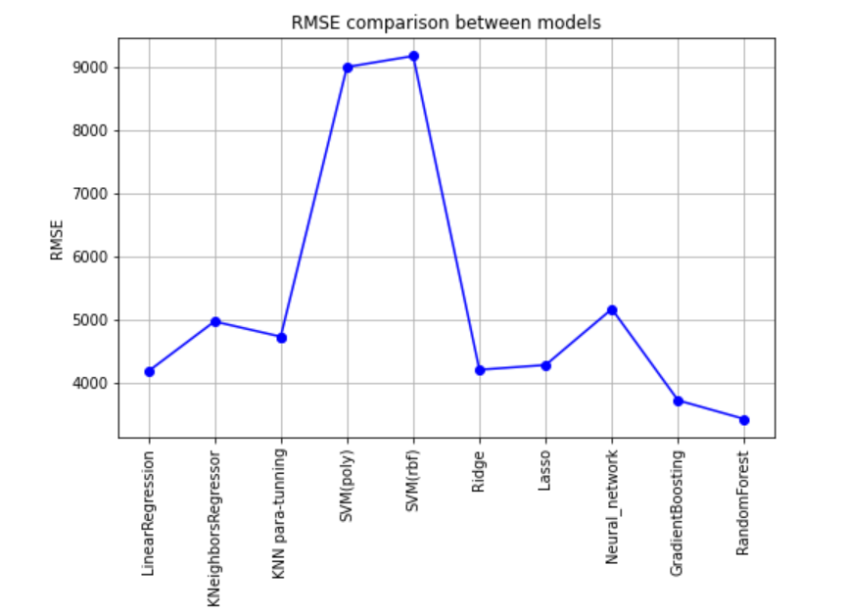
Model Trying(Approach 2)
Linear regression which is our base model
KNN
KNN para-tunning
SVM (Poly)
SVM (rbf)
Ridge
Lasso
Neural_network
GradientBoosting
RandomForest

Slide 22
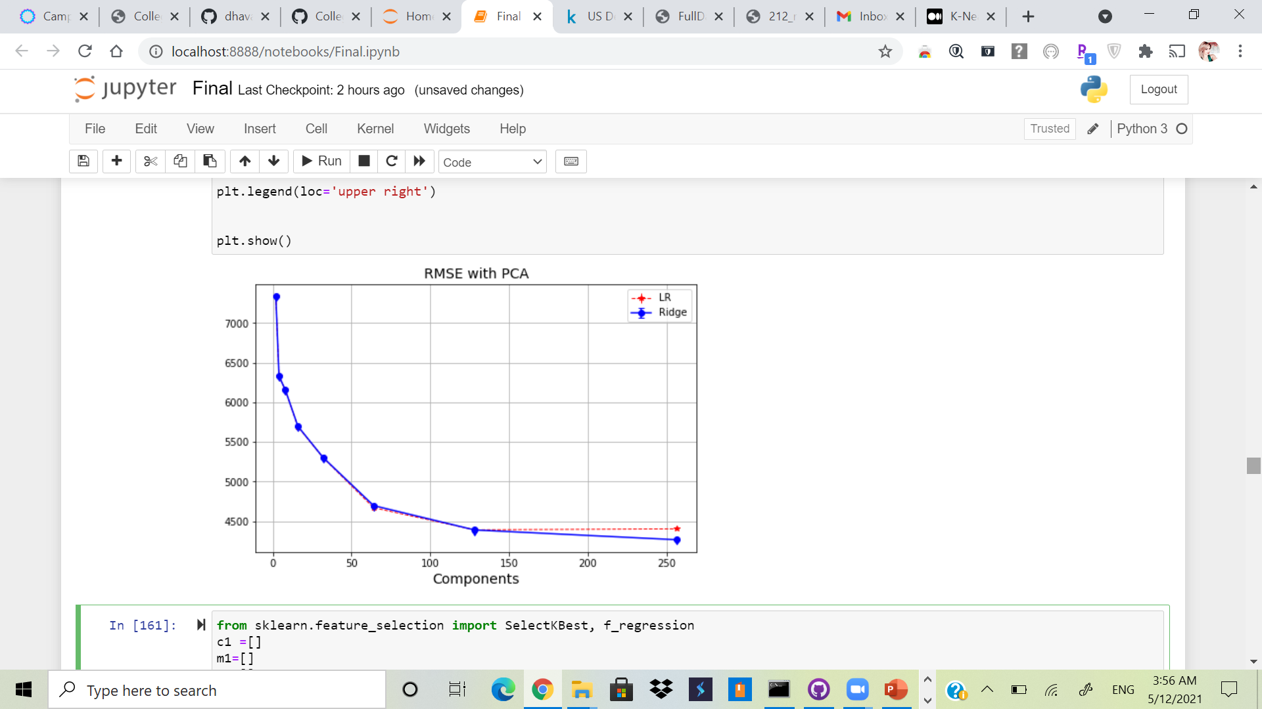
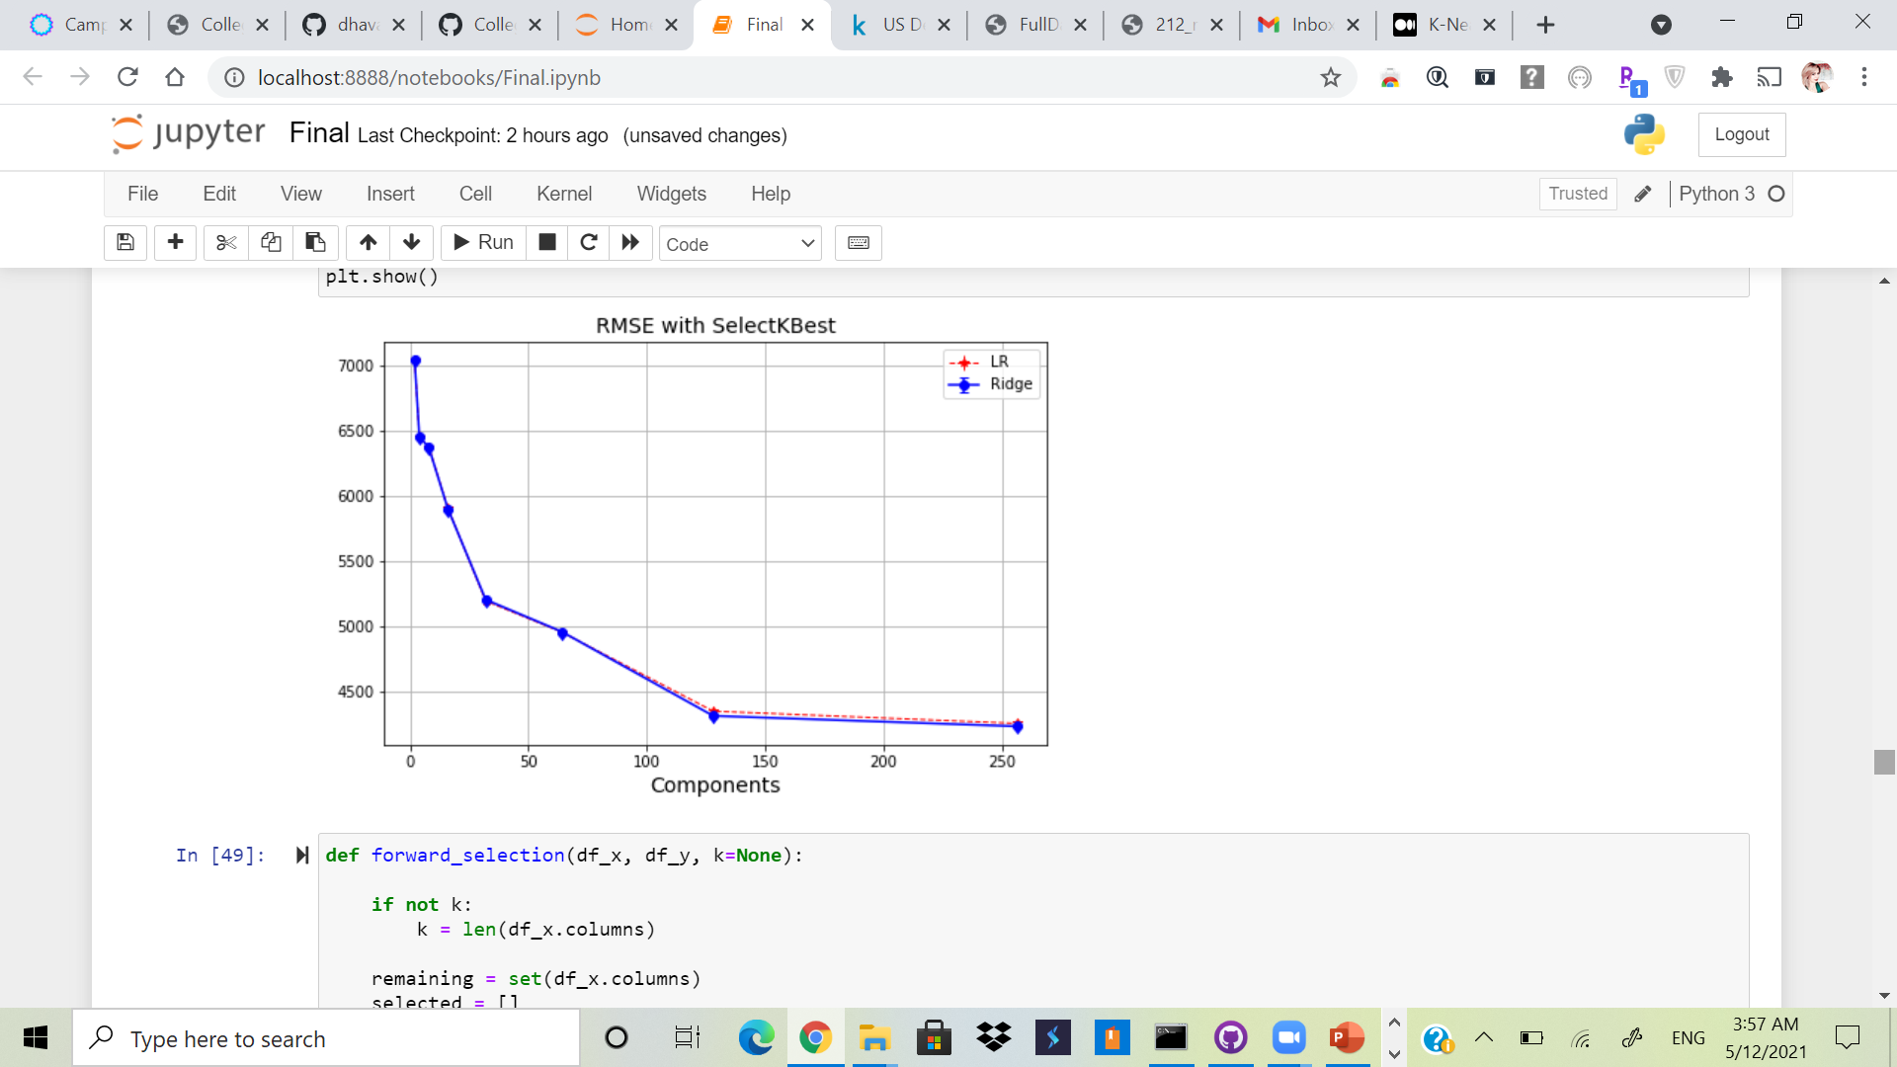
Model Trying(Approach 2)

Slide 23
Model Trying(Approach 2)
Forward Stepwise Selection
5 significant features:
PCIP12 : Percentage of degrees awarded in Personal And Culinary Services.
UFDS-ASIAN : Total share of enrollment of undergraduate degree-seeking students who are Asian.
IND_INC_PCT : Percentage of students who are financially dependent and have family incomes between $0-30,000.
HCM_2 : Schools that are on Heightened Cash Monitoring 2 by the Department of Education.
PCIP50 : Percentage of degrees awarded in Visual And Performing Arts.

Slide 24
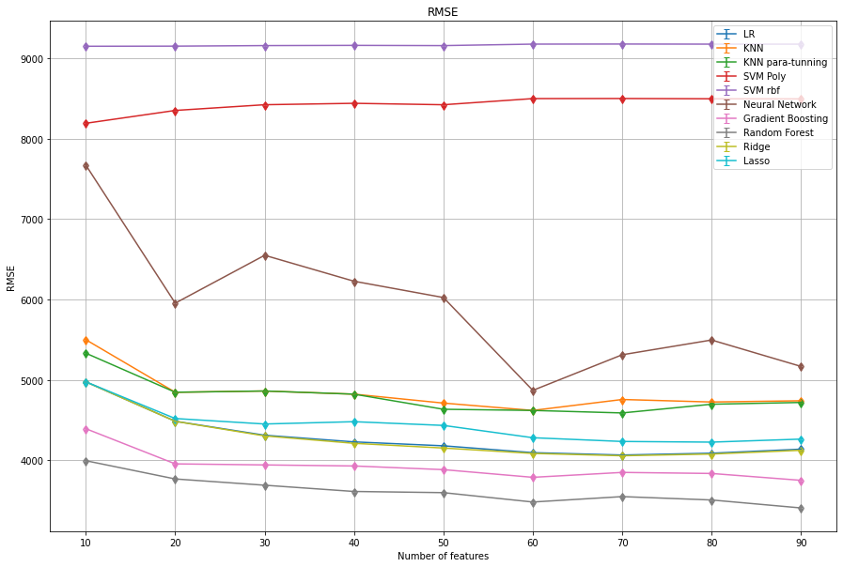

Slide 25

Thank you !

